Slide 1

Data Analysis Based Recommendation System for a Company
Sandipan Chowdhury – 11500116049
Nishant Kumar – 11500116073
Olivia Mukherjee – 11500117011
Rahul Singh – 11500116061
Report for Project (CS794)
Under the Supervision of
Mr. Subhasis Mallick, Assistant Professor, CSE Department
B.P. Poddar Institute Of Management and Technology

Slide 2
ACKNOWLEDGEMENT
We have taken efforts in this project. However, it would not have been possible without the kind support and help of many individuals. I would like to extend my sincere thanks to all of them.
We are highly indebted to Mr. Subhasis Mallick for his guidance and constant supervision as well as for providing necessary information regarding the project & also for their support in completing the project.
We would like to express our special gratitude and thanks to Mr. Subhasis Mallick for giving our attention and time. Our thanks and appreciations also go to my colleague in developing the project and people who have willingly helped us out with their abilities.

Slide 3
Introduction
In this 21st century of technology, we are progressing towards smarter concepts and tools day by day. Nowadays it is possible to shop while sitting at home, by e-commerce. Just a mobile number or an email id and a bank account is needed to do online shopping. Various companies (like Amazon, Flipkart, Snapdeal etc.) provide us the facility of good online shopping.
These companies also seek help from various tools and concepts to get an idea about how they can increase their profit. Such a concept is Data Science. A Data Scientist can analyze the sales data of an e-commerce company, and build a recommendation system to give an optimized business strategy to that company.

Slide 4
Objectives
In this project, we have 2 dataset of Flipkart Company …… one containing informations about customers, another containing informations about offers. We will analyze these datasets with predictive model and linear regression, and calculate the optimized business strategy for Flipkart Company for next year.

Slide 5
Defining Project and Gathering Background Knowledge
Learning of Data Science and Predictive Model
Learning of Linear Regression
Working Steps
Discussions on the topics we learnt
Analysis of Datasets
Procurement of Project’s Solution

Slide 6
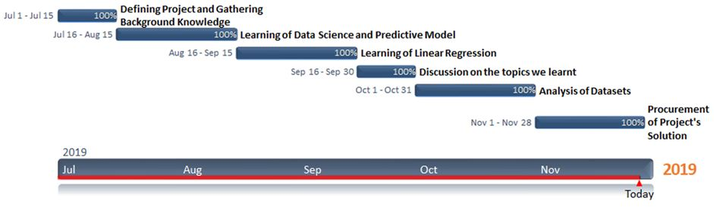
Activity Chart (Gantt Chart)

Slide 7
Data Science
Data science is a multi-disciplinary field that uses scientific methods, processes, algorithms and systems to extract knowledge and insights from structured and unstructured data. Data science is the same concept as data mining and big data: "use the most powerful hardware, the most powerful programming systems, and the most efficient algorithms to solve problems".
Data science is a "concept to unify statistics, data analysis, machine learning and their related methods" in order to "understand and analyze actual phenomena" with data. It employs techniques and theories drawn from many fields within the context of mathematics, statistics, computer science, and information science. Turing award winner Jim Gray imagined data science as a "fourth paradigm" of science (empirical, theoretical, computational and now data-driven) and asserted that "everything about science is changing because of the impact of information technology" and the data deluge. In 2015, the American Statistical Association identified database management, statistics and machine learning, and distributed and parallel systems as the three emerging foundational professional communities.

Slide 8
Predictive Models
Predictive modeling uses statistics to predict outcomes. Most often the event one wants to predict is in the future, but predictive modeling can be applied to any type of unknown event, regardless of when it occurred. For example, predictive models are often used to detect crimes and identify suspects, after the crime has taken place.
In many cases the model is chosen on the basis of detection theory to try to guess the probability of an outcome given a set amount of input data, for example given an email determining how likely that it is spam.
Models can use one or more classifiers in trying to determine the probability of a set of data belonging to another set. For example, a model might be used to determine whether an email is spam or "ham" (non-spam).
Depending on definitional boundaries, predictive modeling is synonymous with, or largely overlapping with, the field of machine learning, as it is more commonly referred to in academic or research and development contexts. When deployed commercially, predictive modeling is often referred to as predictive analytics.
Predictive modeling is often contrasted with causal modeling/analysis. In the former, one may be entirely satisfied to make use of indicators of, or proxies for, the outcome of interest. In the latter, one seeks to determine true cause-and-effect relationships. This distinction has given rise to a burgeoning literature in the fields of research methods and statistics and to the common statement that "correlation does not imply causation".

Slide 9
E-Commerce
E-commerce (electronic commerce) is the activity of electronically buying or selling of products on online services or over the Internet. Electronic commerce draws on technologies such as mobile commerce, electronic funds transfer, supply chain management, Internet marketing, online transaction processing, electronic data interchange (EDI), inventory management systems, and automated data collection systems. E-commerce is in turn driven by the technological advances of the semiconductor industry, and is the largest sector of the electronics industry.
Modern electronic commerce typically uses the World Wide Web for at least one part of the transaction's life cycle although it may also use other technologies such as e-mail. Typical e-commerce transactions include the purchase of online books (such as Amazon) and music purchases (music download in the form of digital distribution such as iTunes Store), and to a less extent, customized/personalized online liquor store inventory services. There are three areas of e-commerce: online retailing, electronic markets, and online auctions. E-commerce is supported by electronic business.

Slide 10
Linear Regression
In statistics, linear regression is a linear approach to modeling the relationship between a scalar response (or dependent variable) and one or more explanatory variables (or independent variables). The case of one explanatory variable is called simple linear regression. For more than one explanatory variable, the process is called multiple linear regression. This term is distinct from multivariate linear regression, where multiple correlated dependent variables are predicted, rather than a single scalar variable.
In linear regression, the relationships are modeled using linear predictor functions whose unknown model parameters are estimated from the data. Such models are called linear models. Most commonly, the conditional mean of the response given the values of the explanatory variables (or predictors) is assumed to be an affine function of those values; less commonly, the conditional median or some other quantile is used. Like all forms of regression analysis, linear regression focuses on the conditional probability distribution of the response given the values of the predictors, rather than on the joint probability distribution of all of these variables, which is the domain of multivariate analysis.

Slide 11
Used Hardware and Software
Hardware
Machine → HP BS658TX (Laptop)
RAM Memory → 8 GB
Hard Disk Memory → 1024 GB
Software
Operating System → Windows 10 Enterprise (64 bit)
Application Software → Jupyter Notebook
Programming Language → Python 3.7.3

Slide 12
Result and Discussion
We have used two datasets . Dataset A contains information about customers. It includes ……
a) Name of Customers
b) Email ID of Customers
c) Phone number of Customers
d) Average time spent on App by each Customer (Minutes / Day)
e) Total Purchase from App by each Customer (Rupees / Year)
f) Average time spent on Website by each Customer (Minutes / Day)
g) Total Purchase from Website by each Customer (Rupees / Year)
h) Length of Membership of each Customer (Year)
i) Yearly Amount Spent by each Customer (Minutes / Year)
j) Total Purchase of each Customer (Rupees / Year)
k) Ratings given by Customer (Out of 5)

Slide 13
Dataset B contains information about offers. It includes …….
a) Name of Offers
b) Number of months in a year (where offer is applied)
c) Profit with offer per year (Rupees / Year)
d) Average Profit with offer per month (Rupees / Month)
e) Number of months in a year (where offer is not applied)
f) Profit without offer per year (Rupees / Year)
g) Average Profit without offer per month (Rupees / Month)

Slide 14
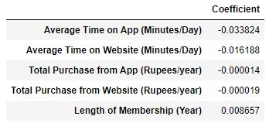
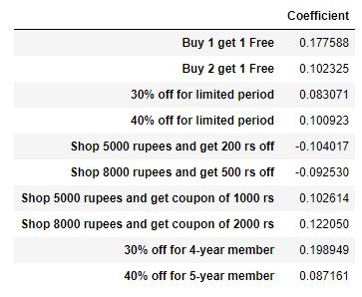
We have applied linear regression to our datasets. Then we built a predictive model of two datasets. From those predictive models, we have calculated the coefficients of important attributes. The attribute with highest coefficient has highest importance.

Slide 15
Our Data Science based analysis shows that “Length of Membership” has highest coefficient (0.008657) in first table and “30% off for 4-year member” has highest coefficient (0.198949) in second table.
So it is convenient that “length of membership” and “30% off for 4-year member” is most important.
Therefore to maximize profit, business strategy of next year should be “30% Price Off For 4-Year Members of Flipkart Company”.

Slide 16
References
Internet Links →
a) https://en.wikipedia.org/wiki/Linear_regression
b) https://en.wikipedia.org/wiki/E-commerce
c) https://en.wikipedia.org/wiki/Data_science
d) https://en.wikipedia.org/wiki/Predictive_modelling
e) https://en.wikipedia.org/wiki/Predictive_analytics
f) https://en.wikipedia.org/wiki/Prediction
g) https://www.investopedia.com/terms/d/data-science.asp
h) https://en.wikipedia.org/wiki/Simple_linear_regression
i) https://en.wikipedia.org/wiki/Regression_analysis

Slide 17
Books→
a) Linear Regression Analysis, Wiley Publications
b) Business Analytics: The Science of Data - Driven Decision Making, Wiley Publications
c) Predictive Analytics for Dummies, Wiley Publications
d) Applied Machine Learning, Tata McGraw Hills Publications
e) Advanced Engineering Mathematics, Wiley Publications

Slide 18
THANK YOU

